Slide 1
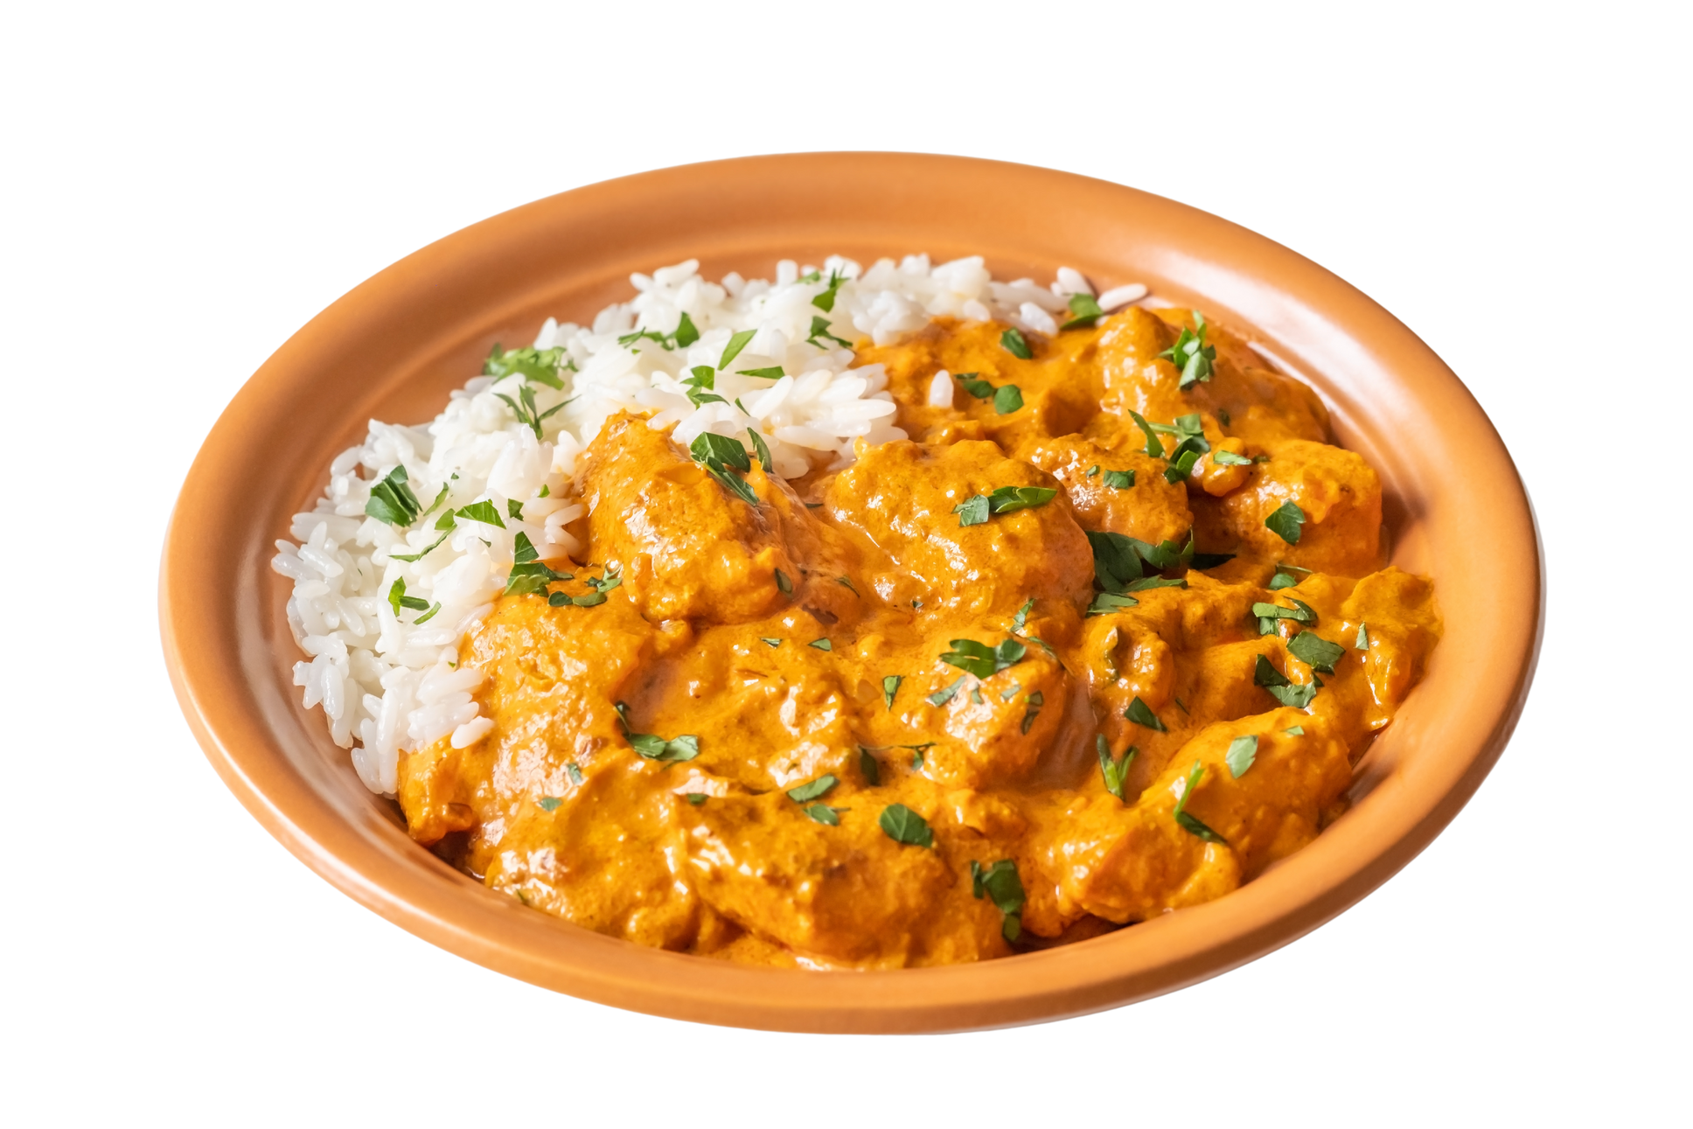

TIKKA MASALA

Slide 2

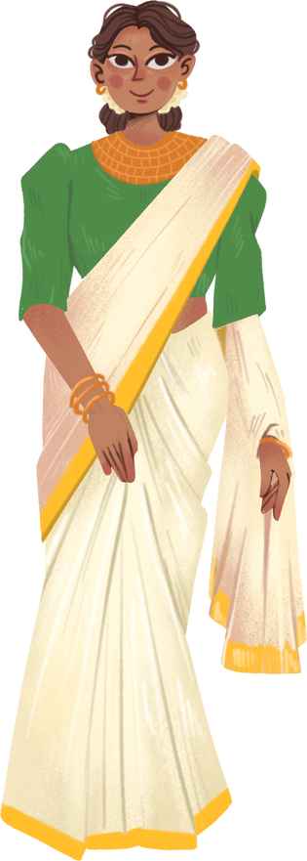
Tikka Masala is created by British influances. It includes various Indian Spices

Slide 3
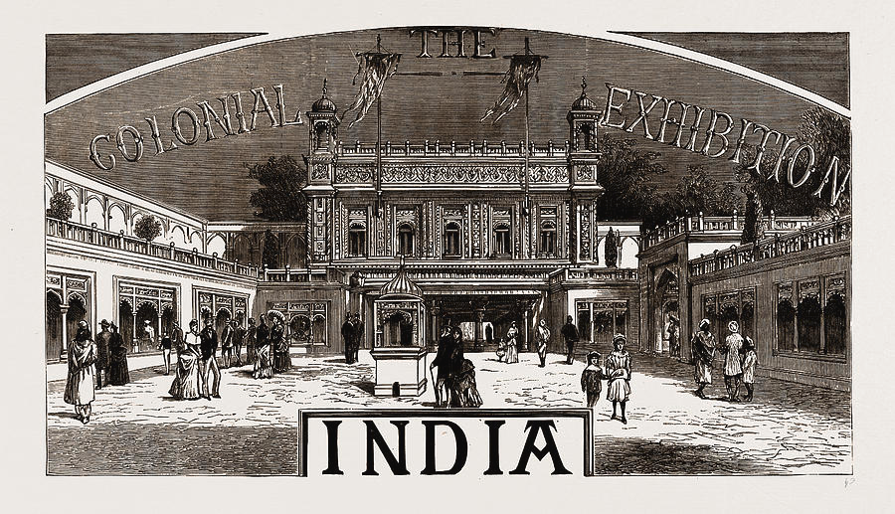
it represants the impact of British Empires impact on Indians

Slide 4
Ingridients
For the Chicken Marinade
500g boneless chicken
1 cup plain yogurt
2 tbsp lemon juice
1 tbsp grated garlic
1 tbsp grated ginger
1 tsp turmeric
1 tsp cumin
1 tsp garam masala
1 tsp chili powder
Salt to taste
For the Masala Sauce
2 tbsp oil or ghee
1 large onion, finely chopped
2 garlic cloves, minced
1 tbsp grated ginger
2 tsp garam masala
1 tsp cumin
1 tsp paprika
1/2 tsp cinnamon
1 can (400g) chopped tomatoes
1/2 cup heavy cream or coconut cream
Salt to taste

Slide 5
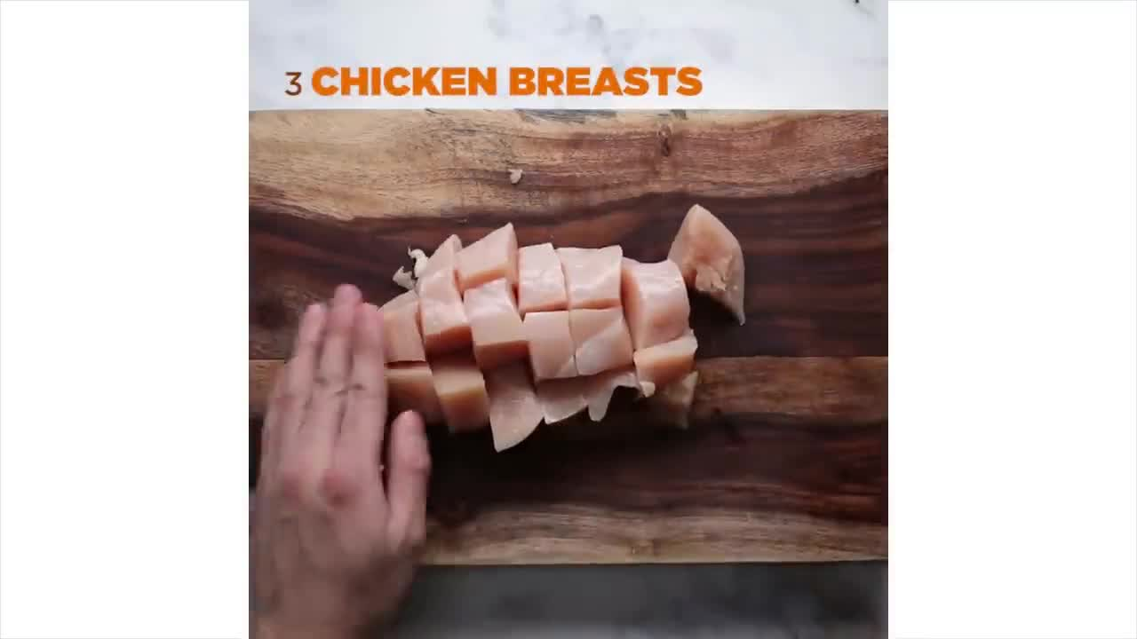
Marinate the Chicken
Mix all marinade ingredients in a bowl. Add chicken and coat well.
Cover and refrigerate for at least 1 hour (preferably overnight).

Slide 6
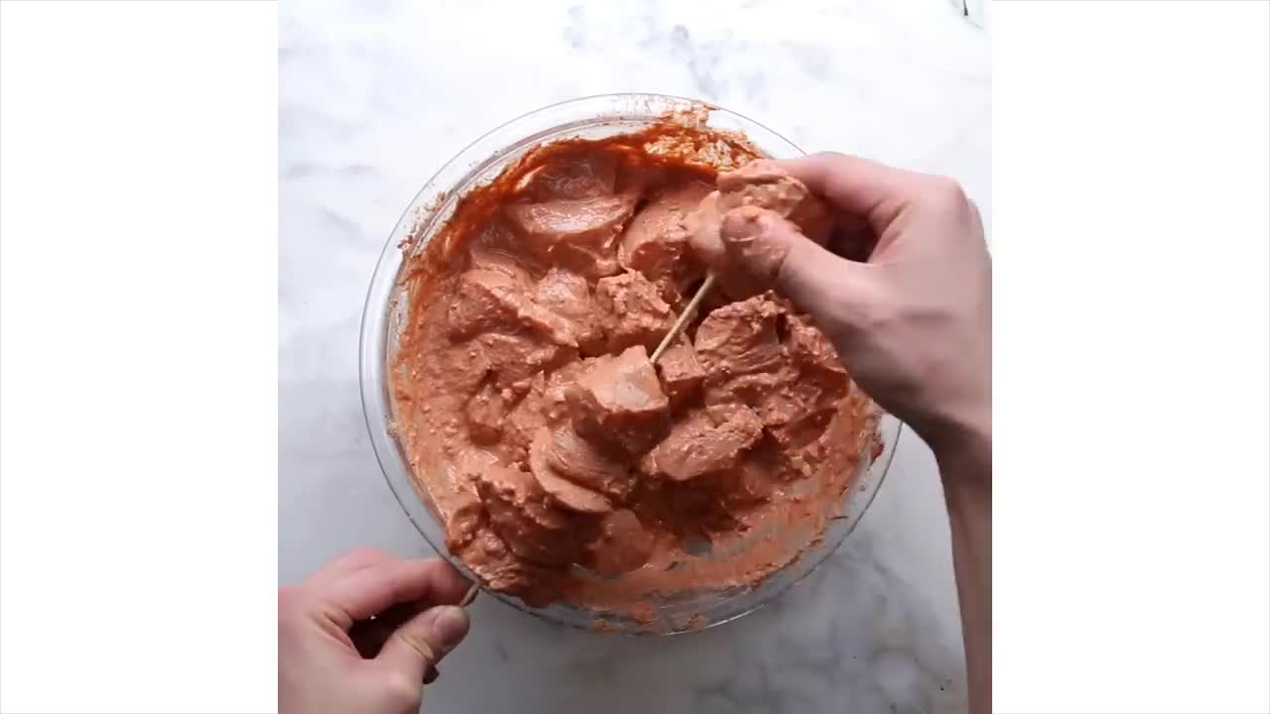
Cook the Chicken
Grill, bake, or sauté the marinated chicken until cooked through. Set aside.

Slide 7
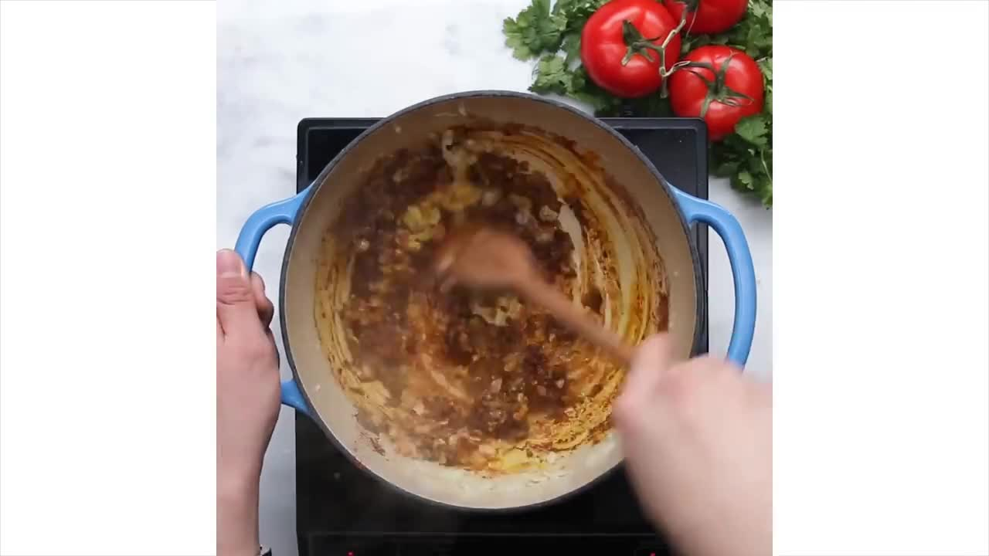
Prepare the Sauce
In a large pan, heat oil/ghee over medium heat.
Add chopped onions, cook until golden.
Stir in garlic and ginger, cook for 1-2 minutes.
Add all the spices, stir for 30 seconds until fragrant.
Pour in chopped tomatoes, simmer for 10 minutes until thickened.
Blend the sauce (optional) for a smoother texture.

Slide 8
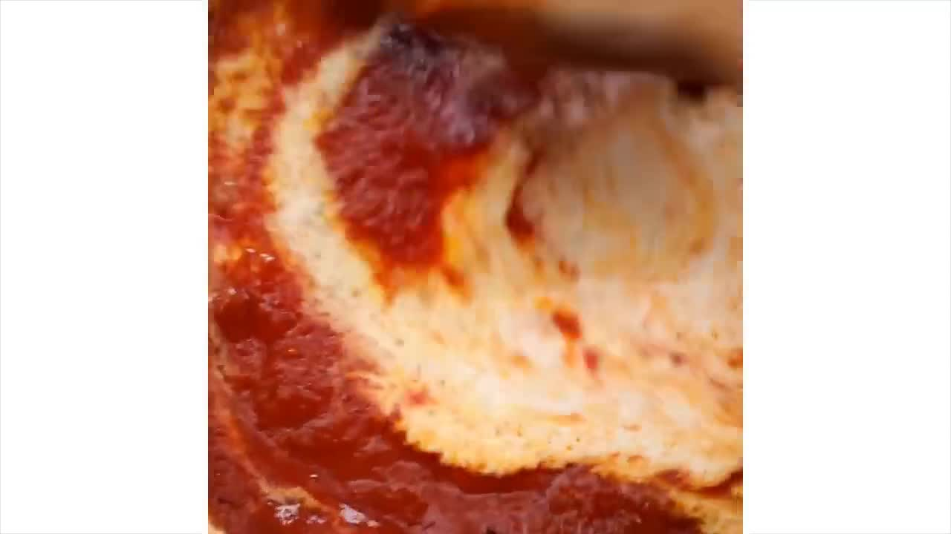
Finish The Dish
Return cooked chicken to the pan.
Add cream and simmer for 10 more minutes.
Adjust salt, garnish with coriander.

Slide 9


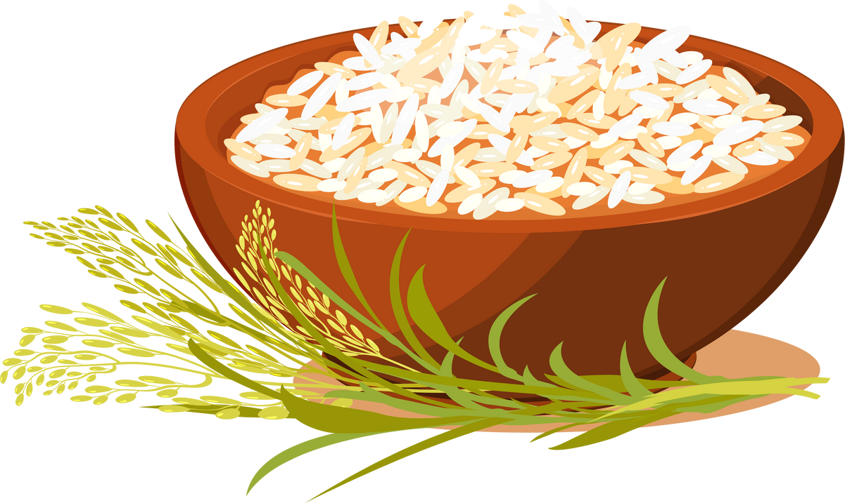
Serve With
naan bread
roti
Basmati rice

Slide 10

Thank You For Listening To Me

